Slide 1

C++11
THE GOOD
THE BAD
THE UGLY
Frank Vasquez

Slide 2
C makes it easy to shoot yourself in the foot. C++ makes it harder, but when you do, it blows away your whole leg.
-Bjarne Stroustrup

Slide 3
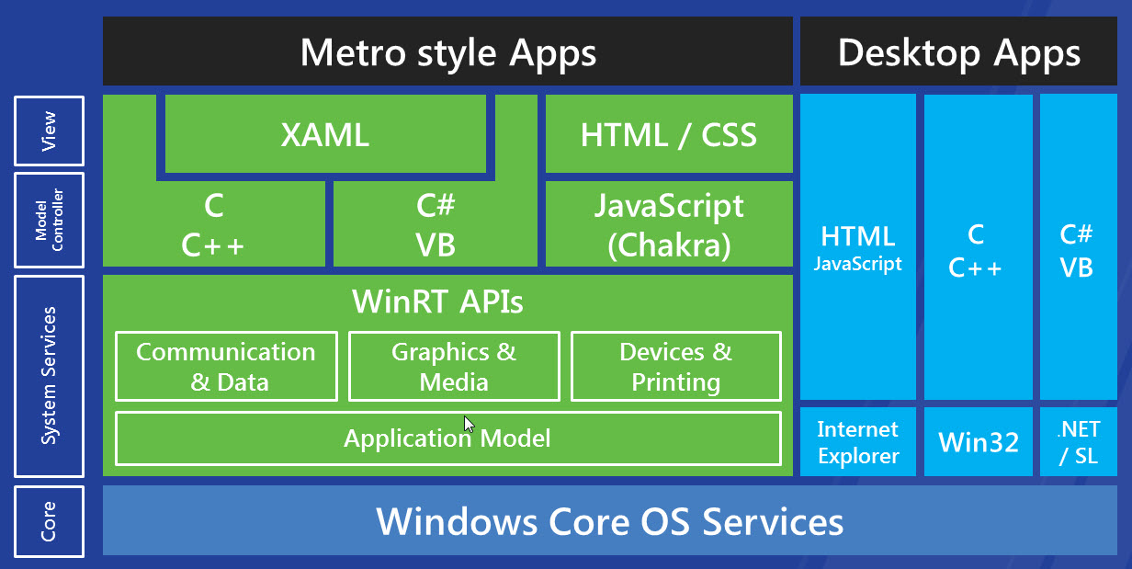
welcome back

Slide 4
standards
C++98
C++03
C++0x == C++11
C++0y == C++14

Slide 5

compilers
clang
gcc
Visual C++

Slide 6
… by and large I think it’s a bad language. It does a lot of things half well and it’s just a garbage heap of ideas that are mutually exclusive. Everybody I know, whether it’s personal or corporate, selects a subset and these subsets are different.
-Ken Thompson

Slide 7

Why?
classes
templates
cross-platform
threads
real-time
native
legacy code

Slide 8
goodies
type inference
terse for loop syntax
lambdas
succinct container initialization
no more new and delete
unique data
simple async tasks

Slide 9
auto
typedef std::vector<std::pair<json::value,json::value>>
element_vector;
json::value::element_vector m_elems;
// json::value::element_vector::iterator it;
auto it = std::begin(m_elems);

Slide 10
range-based for
// bad old days
for (std::vector<int>::iterator it = v.begin(); it != v.end(); ++it) {
sum += *it;
}
// now
for (auto& num : v) {
sum += num;
}

Slide 11
lamda types
// std::function<bool (const string&)> func;
auto func = [] (const string &name) {
return false;
};

Slide 12
lambdas
// Find next available UDP port
auto findUDPPort = [] (boost::asio::io_service &io) {
udp::socket probe(io, udp::endpoint(udp::v4(), 0));
udp::endpoint dataEndPoint = probe.local_endpoint();
return dataEndPoint.port();
};

Slide 13
lambda as predicate
std::wstring month(3, L'\0');
// scanf month
std::wstring names[12] = {L"Jan", L"Feb", … , L"Dec"};
auto loc = std::find_if(std::begin(names), std::end(names),
[&month] (const std::wstring& m) { return m == month; });
if (loc != std::end(names) {
sysTime.wMonth = (short) ((loc - names) + 1);
}

Slide 14
lamda-friendly stl algorithms
all_of
any_of
none_of
for_each
find_if
find_if_not
count_if
copy_if
replace_if
replace_copy_if
remove_if
remove_copy_if

Slide 15
variable capture
bool _open_fsb_str(_filestream_callback *callback,
const char *filename, std::ios_base::openmode mode, int prot)
{
std::string name(filename);
pplx::create_task([=] () -> void
{
int cmode = get_open_flags(mode);
if (cmode==O_RDWR) { cmode |= O_CREAT; }
int f = open(name.c_str(), cmode, 0600);
_finish_create(f, callback, mode, prot);
});
return true;
}

Slide 16
capture specification
[] Capture nothing
[&] Capture any referenced variable by reference
[=] Capture any referenced variable by making a copy
[&foo] Capture variable foo by reference
[bar] Capture just bar by making a copy
[this] Capture the this pointer of the enclosing class

Slide 17
initializer lists
/*
std::vector<string> v;
v.push_back(“rock”);
v.push_back(“paper”);
v.push_back(“scissors”);
*/
std::vector<string> v = { “rock”, “paper”, “scissors” };

Slide 18
shared_ptr
// shared ownership
std::shared_ptr<Quadruped> _pet;
_pet = std::make_shared<Quadruped>(“Scotty”);
// no more new or delete
// reference counting

Slide 19
weak_ptr
// non-owning reference to a shared_ptr
std::weak_ptr<Quadruped> wp = _pet;
if (auto sp = wp.lock()) {
// work with unexpired shared pointer
}
// does not contribute to reference count
// breaks cycles

Slide 20
unique_ptr
// single owner
std::unique_ptr<Vehicle> _transport;
_transport = new Vehicle(“Ford”);
// ownership can be transferred

Slide 21
rvalue references
void foo(Bar && bar);
Bar snickers; // lvalue
foo(snickers); // compiler error
foo(Bar()); // cool
// no deep copy
// destructor only called once

Slide 22
move semantics
// move constructor
Buffer(Buffer&& temp)
{
std::swap(*this, temp);
}
string lvalue = “movable”;
v.push_back(std::move(lvalue));

Slide 23
… a folk definition of insanity is to do the same thing over and over again and to expect the results to be different. By this definition, we in fact require that programmers of multithreaded systems be insane. Were they sane, they could not understand their programs.
-Edward Lee
Professor, EECS Department, UC Berkeley

Slide 24
async
vector<future<string>> futures;
vector<string> names = { "Futura", Dondi", "Chaka" };
for (auto& name : names) {
// launch::deferred vs launch::async
futures.push_back(async([&name] { return flip(move(name)); }));
}
for (auto& ftr : futures) {
cout << ftr.get() << endl;
}

Slide 25
unique data
string flip(string && name)
{
cout << this_thread::get_id() << endl;
reverse(begin(name), end(name));
return name;
}
// name ownership transferred to flip tasks
// name[s] empty in main after moving
// avoids races

Slide 26

projects
Folly
http://github.com/facebook/folly
Casablanca
http://casablanca.codeplex.com
Cinder
http://libcinder.org

Slide 27
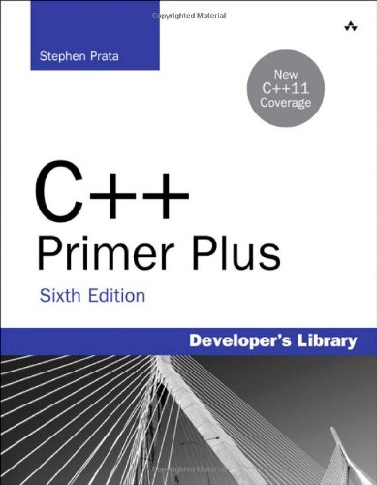
books
C++ Concurrency in Action
by Anthony Williams
Effective C++ series
by Scott Meyers
Exceptional C++ series
by Herb Sutter

Slide 28
credits
Elements of Modern C++ Style
by Herb Sutter
http://herbsutter.com/elements-of-modern-c-style
C++11 Concurrency
9 part video series by Bartosz Milewski
http://www.youtube.com/watch?v=80ifzK3b8QQ&list

